Slide 1
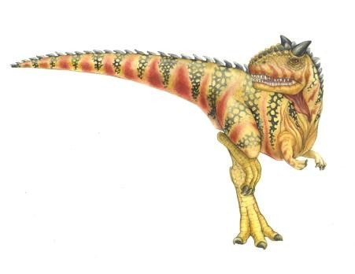
Chapter 15: Security
Operating System Concepts – 9th Edition

Slide 2
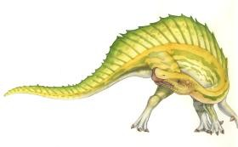
Chapter 15: Security
The Security Problem
Program Threats
System and Network Threats
Cryptography as a Security Tool
User Authentication
Implementing Security Defenses
Firewalling to Protect Systems and Networks
Computer-Security Classifications
An Example: Windows 7

Slide 3
Objectives
To discuss security threats and attacks
To explain the fundamentals of encryption, authentication, and
hashing
To examine the uses of cryptography in computing
To describe the various countermeasures to security attacks

Slide 4
The Security Problem
System secure if resources used and accessed as intended under all circumstances
Unachievable
Intruders (crackers) attempt to breach security
Threat is potential security violation
Attack is attempt to breach security
Attack can be accidental or malicious
Easier to protect against accidental than malicious misuse

Slide 5
Security Violation Categories
Breach of confidentiality
Unauthorized reading of data
Breach of integrity
Unauthorized modification of data
Breach of availability
Unauthorized destruction of data
Theft of service
Unauthorized use of resources
Denial of service (DOS)
Prevention of legitimate use

Slide 6
Security Violation Methods
Masquerading (breach authentication)
Pretending to be an authorized user to escalate privileges
Replay attack
As is or with message modification
Man-in-the-middle attack
Intruder sits in data flow, masquerading as sender to receiver
and vice versa
Session hijacking
Intercept an already-established session to bypass
authentication

Slide 7
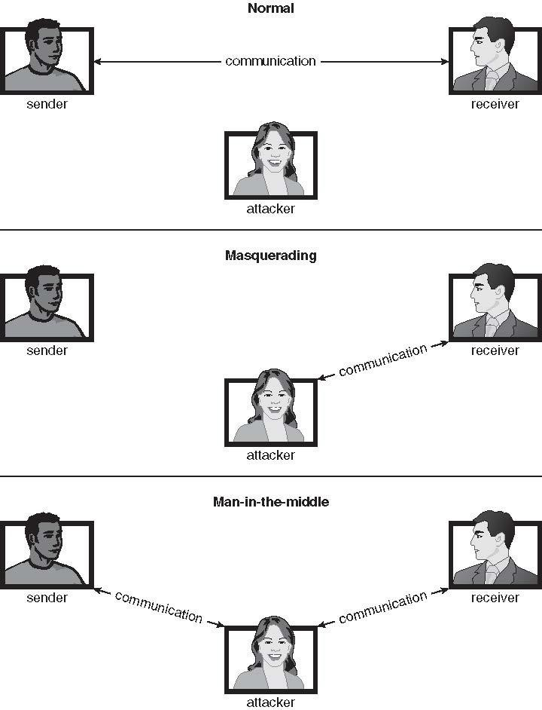
Standard Security Attacks

Slide 8
Security Measure Levels
Impossible to have absolute security, but make cost to perpetrator sufficiently high to deter most intruders
Security must occur at four levels to be effective:
Physical
 Data centers, servers, connected terminals
Human
 Avoid social engineering, phishing, dumpster diving
Operating System
 Protection mechanisms, debugging
Network
 Intercepted communications, interruption, DOS
Security is as weak as the weakest link in the chain
But can too much security be a problem?

Slide 9
Program Threats
Many variations, many names
Trojan Horse
Code segment that misuses its environment
Exploits mechanisms for allowing programs written by users to be
executed by other users
Spyware, pop-up browser windows, covert channels
Up to 80% of spam delivered by spyware-infected systems
Trap Door
Specific user identifier or password that circumvents normal security procedures
Could be included in a compiler
How to detect them?

Slide 10
Program Threats (Cont.)
Logic Bomb
Program that initiates a security incident under certain
circumstances
Stack and Buffer Overflow
Exploits a bug in a program (overflow either the stack or
memory buffers)
Failure to check bounds on inputs, arguments
Write past arguments on the stack into the return address on stack
When routine returns from call, returns to hacked address
 Pointed to code loaded onto stack that executes malicious code
Unauthorized user or privilege escalation
15.10

Slide 11
C Program with Buffer-overflow Condition
#include <stdio.h>
#define BUFFER SIZE 256
int main(int argc, char *argv[])
{
char buffer[BUFFER SIZE]; if (argc < 2)
return -1;
else {
strcpy(buffer,argv[1]);
return 0;
}
}

Slide 12
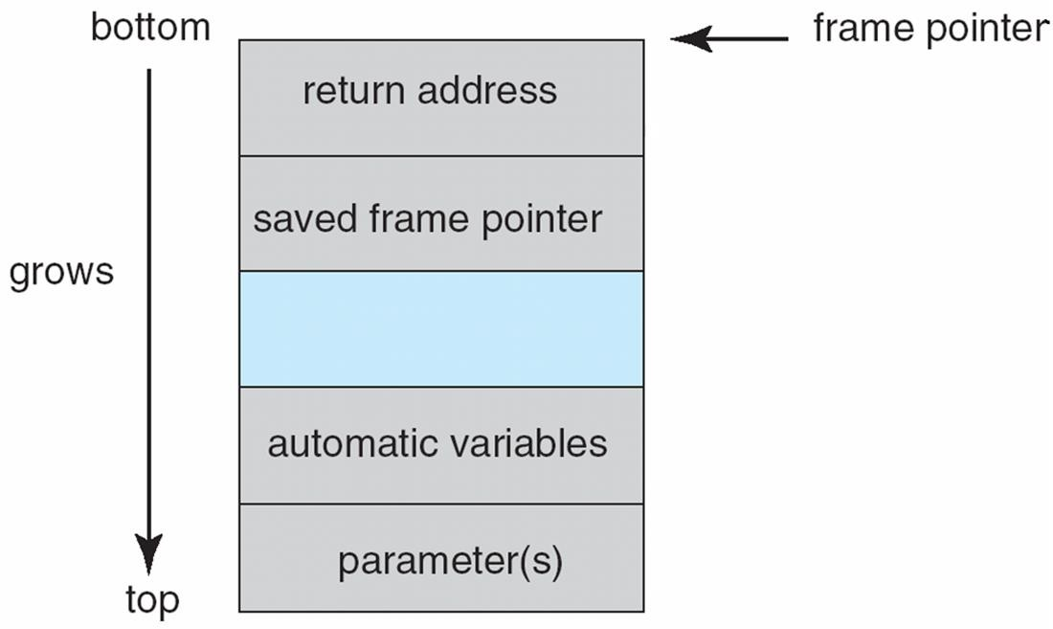
Layout of Typical Stack Frame

Slide 13


Modified Shell Code
#include <stdio.h>
int main(int argc, char *argv[])
{
execvp(
NULL);
return 0;
\bin\sh , \bin \sh
,
}

Slide 14
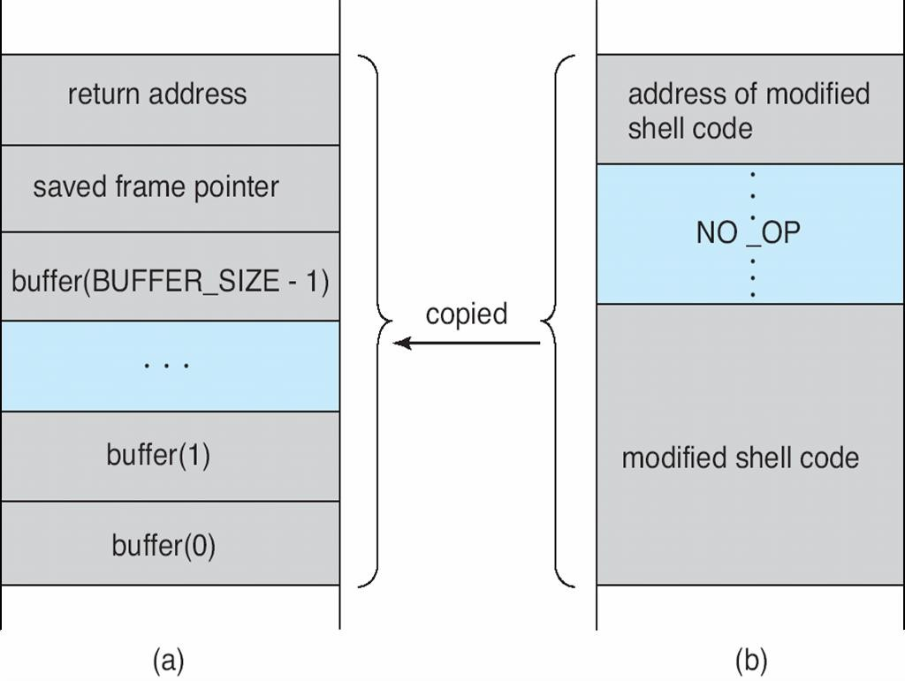
Hypothetical Stack Frame
Before attack
After attack

Slide 15



Great Programming Required?
For the first step of determining the bug, and second step of writing exploit code, yes
Script kiddies can run pre-written exploit code to attack a given system
Attack code can get a shell with the processes owner s
permissions
Or open a network port, delete files, download a program, etc
Depending on bug, attack can be executed across a network using allowed connections, bypassing firewalls
Buffer overflow can be disabled by disabling stack execution or
adding bit to page table to indicate
Available in SPARC and x86
But still have security exploits
non-executable state

Slide 16
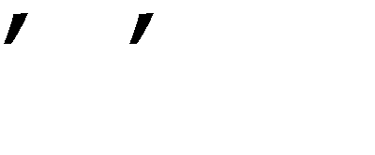
Program Threats (Cont.)
Viruses
Code fragment embedded in legitimate program
Self-replicating, designed to infect other computers
Very specific to CPU architecture, operating system, applications
Usually borne via email or as a macro
Visual Basic Macro to reformat hard drive
Sub AutoOpen()
Dim oFS
Set oFS = CreateObject( Scripting.FileSystemObject vs = Shell( c:command.com /k format c: ,vbHide)
End Sub
)

Slide 17
Program Threats (Cont.)
Virus dropper inserts virus onto the system
Many categories of viruses, literally many thousands of viruses
File / parasitic
Boot / memory
Macro
Source code
Polymorphic to avoid having a virus signature
Encrypted
Stealth
Tunneling
Multipartite
Armored

Slide 18
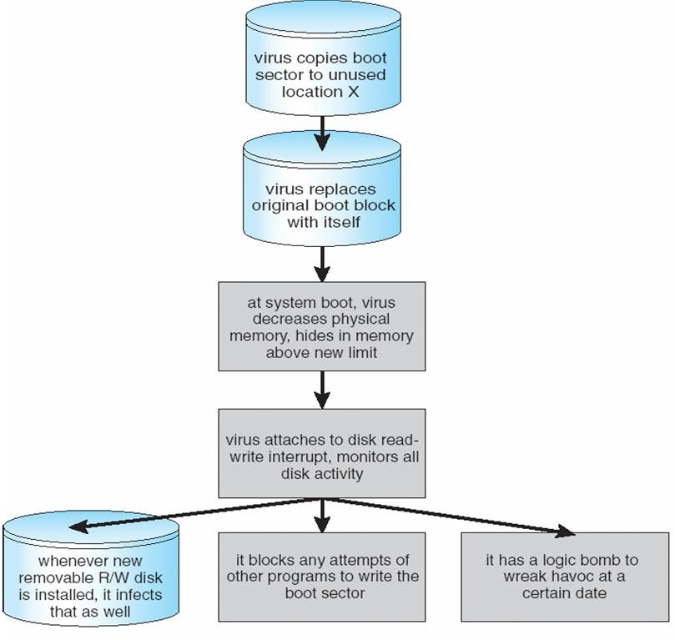
A Boot-sector Computer Virus

Slide 19
The Threat Continues
Attacks still common, still occurring
Attacks moved over time from science experiments to tools of
organized crime
Targeting specific companies
Creating botnets to use as tool for spam and DDOS delivery
Keystroke logger to grab passwords, credit card numbers
Why is Windows the target for most attacks?
Most common
Everyone is an administrator
 Licensing required?
Monoculture considered harmful

Slide 20
System and Network Threats
Some systems open rather than secure by default
Reduce attack surface
But harder to use, more knowledge needed to administer
Network threats harder to detect, prevent
Protection systems weaker
More difficult to have a shared secret on which to base access
No physical limits once system attached to internet
 Or on network with system attached to internet
Even determining location of connecting system difficult
 IP address is only knowledge
15.20

Slide 21
System and Network Threats (Cont.)
Worms – use spawn mechanism; standalone program
Internet worm
Exploited UNIX networking features (remote access) and bugs in finger and sendmail programs
Exploited trust-relationship mechanism used by rsh to access
friendly systems without use of password
Grappling hook program uploaded main worm program
 99 lines of C code
Hooked system then uploaded main code, tried to attack
connected systems
Also tried to break into other users accounts on local system via password guessing
If target system already infected, abort, except for every 7th time

Slide 22
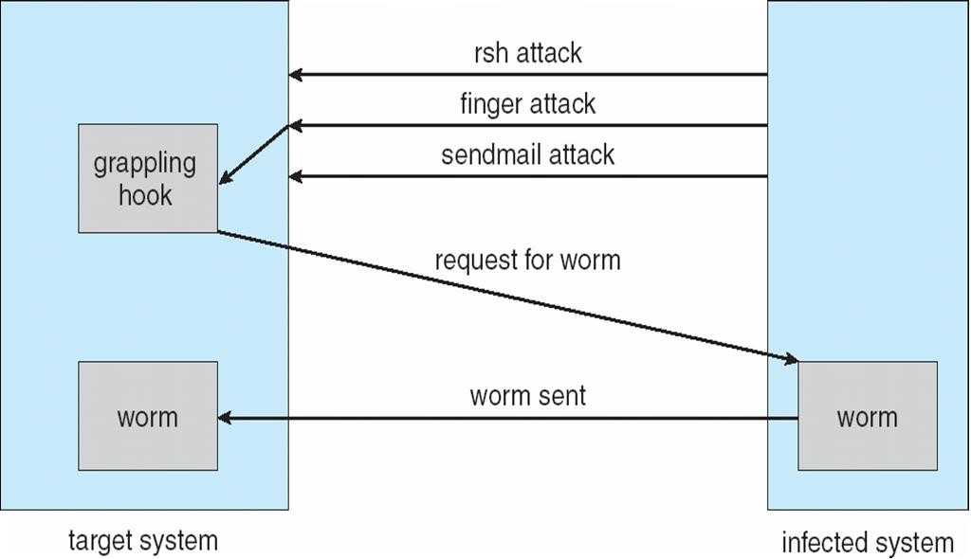
The Morris Internet Worm

Slide 23
System and Network Threats (Cont.)
Port scanning
Automated attempt to connect to a range of ports on one
or a range of IP addresses
Detection of answering service protocol
Detection of OS and version running on system
nmap scans all ports in a given IP range for a response
nessus has a database of protocols and bugs (and
exploits) to apply against a system
Frequently launched from zombie systems
 To decrease trace-ability

Slide 24
System and Network Threats (Cont.)
Denial of Service
Overload the targeted computer preventing it from doing any useful work
Distributed denial-of-service (DDOS) come from multiple
sites at once
Consider the start of the IP-connection handshake (SYN)
 How many started-connections can the OS handle?
Consider traffic to a web site
 How can you tell the difference between being a target
and being really popular?
Accidental – CS students writing bad fork() code
Purposeful – extortion, punishment

Slide 25
Sobig.F Worm
More modern example
Disguised as a photo uploaded to adult newsgroup via account
created with stolen credit card
Targeted Windows systems
Had own SMTP engine to mail itself as attachment to everyone in
infect system s address book
Disguised with innocuous subject lines, looking like it came from
someone known
Attachment was executable program that created WINPPR23.EXE
in default Windows system directory
Plus the Windows Registry
[HKCU\SOFTWARE\Microsoft\Windows\CurrentVersion\Run]
"TrayX" = %windir%\winppr32.exe /sinc
[HKLM\SOFTWARE\Microsoft\Windows\CurrentVersion\Run] "TrayX" = %windir%\winppr32.exe /sinc

Slide 26
Cryptography as a Security Tool
Broadest security tool available
Internal to a given computer, source and destination of
messages can be known and protected
 OS creates, manages, protects process IDs, communication ports
Source and destination of messages on network cannot be trusted without cryptography
 Local network – IP address?
Consider unauthorized host added
 WAN / Internet – how to establish authenticity
Not via IP address

Slide 27
Cryptography
Means to constrain potential senders (sources) and / or receivers (destinations) of messages
Based on secrets (keys)
Enables
 Confirmation of source
 Receipt only by certain destination
 Trust relationship between sender and receiver
Notes:
การเข้ารหัส เป็นการใช้ key ต้นทางอยูที่ไหนผู้รับคือใคร

Slide 28
Encryption
Constrains the set of possible receivers of a message
Encryption algorithm consists of
Set K of keys
Set M of Messages
Set C of ciphertexts (encrypted messages)
A function E : K → (M→C). That is, for each k ∈ K, E_{k} is a function for generating ciphertexts from messages
 Both E and E_{k} for any k should be efficiently computable
functions
A function D : K → (C → M). That is, for each k ∈ K, D_{k} is a
function for generating messages from ciphertexts
 Both D and D_{k} for any k should be efficiently computable functions
Notes:
เอา key มาผสม message แล้วได้ ciphertexts ต้องคำนาวอย่างมีประสิทธิภาพมากพอ E=Encrypt D=Decrypt ที่จะEncrypt,Decrypt M ได้

Slide 29
Encryption (Cont.)
An encryption algorithm must provide this essential property: Given a ciphertext c ∈ C, a computer can compute m such that E_{k}(m) = c only if it possesses k
Thus, a computer holding k can decrypt ciphertexts to the plaintexts used to produce them, but a computer not holding k cannot decrypt ciphertexts
Since ciphertexts are generally exposed (for example, sent on the network), it is important that it be infeasible to derive k from the ciphertexts
Notes:
บอกว่า คุณสมบัติที่สำคัญคือ ถ้ามี cyphertext C แล้ว คอมพิวเตอร์จะ compute C กลับมาได้ โดยต้องการันตีได้ว่า key ต้องมีควม unique โดยเราจะหาkeyมาได้ไหม? เพราะฉะนั้นปกติแล้ว cyphettext ทุกคนเห็นได้ทุกคนจึงมีโอกาส reverse textได้

Slide 30
Symmetric Encryption
Same key used to encrypt and decrypt
Therefore k must be kept secret
DES was most commonly used symmetric block-encryption algorithm (created
by US Govt)
Encrypts a block of data at a time
Keys too short so now considered insecure
Triple-DES considered more secure
Algorithm used 3 times using 2 or 3 keys
For example
2001 NIST adopted new block cipher - Advanced Encryption Standard (AES)
Keys of 128, 192, or 256 bits, works on 128 bit blocks
RC4 is most common symmetric stream cipher, but known to have vulnerabilities
Encrypts/decrypts a stream of bytes (i.e., wireless transmission)
Key is a input to pseudo-random-bit generator
 Generates an infinite keystream
15.30
Notes:
ใช้ Key ตัวเดียว จุดอ่อนคือต้องเก็บคีย์ไว้ดีๆ เพื่อส่งคีย์ไปทั้งสองฝั่งโดยวิธีการที่ secureสูงหรือต้องมาเจอกัน เช่น AES ใช้คีย์ได้ตั้งแต่ 128 192 256 ยิ่ง bit เยอะเวลาที่ใช้เข้ารหัสถอดรหัสเยอะ แต่ sec ดี

Slide 31
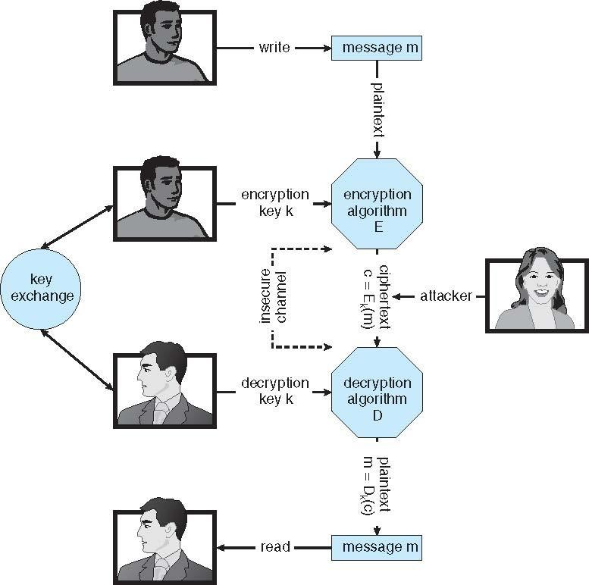
Secure Communication over Insecure Medium
Notes:
สมมุติว่า มี Sender write Message m Sender และ Reciver ต้องแลกคีย์ อ่าน Cypher text โดย Key Exchange สำคัญมากว่าต้องปลอดภัยมากๆ

Slide 32
Asymmetric Encryption
Public-key encryption based on each user having two keys:
public key – published key used to encrypt data
private key – key known only to individual user used to decrypt data
Must be an encryption scheme that can be made public
without making it easy to figure out the decryption scheme
Most common is RSA block cipher
Efficient algorithm for testing whether or not a number is prime
No efficient algorithm is know for finding the prime factors
of a number
Notes:
มีKey 2 ตัว คือ Public Key คือหาได้เจอได้ใน Internet ส่ง Public Encrypt รับใช้ Private Key ถอด

Slide 33
Asymmetric Encryption (Cont.)
Formally, it is computationally infeasible to derive k_{d,N} from k_{e,N}, and so k_{e} need not be kept secret and can be widely disseminated
k_{e} is the public key
k_{d} is the private key
N is the product of two large, randomly chosen prime numbers p and q (for example, p and q are 512 bits each)
Encryption algorithm is E_{ke,N}(m) = m^{k}e mod N, where k_{e}
satisfies k_{e}k_{d} mod (p−1)(q −1) = 1
The decryption algorithm is then D_{kd,N}(c) = c^{k}d mod N
Notes:
มักใช้ Facetor ของ Prime number \\\ สมมุติว่า N เป็นตัวใหญ่มาก แล้วมีสมการ Encrypt อยู่ และ Decrypt อยู่

Slide 34
Asymmetric Encryption Example
For example. make p = 7and q = 13
We then calculate N = 7∗13 = 91 and (p−1)(q−1) = 72
We next select k_{e} relatively prime to 72 and< 72, yielding 5
Finally, we calculate k_{d} such that k_{e}k_{d} mod 72 = 1, yielding 29
We how have our keys
Public key, k_{e,N} = 5, 91
Private key, k_{d,N} = 29, 91
Encrypting the message 69 with the public key results in the cyphertext 62
Cyphertext can be decoded with the private key
Public key can be distributed in cleartext to anyone who
wants to communicate with holder of public key
Notes:
ตามเนี้ย Revert ไม่ได้ ยากมาก

Slide 35
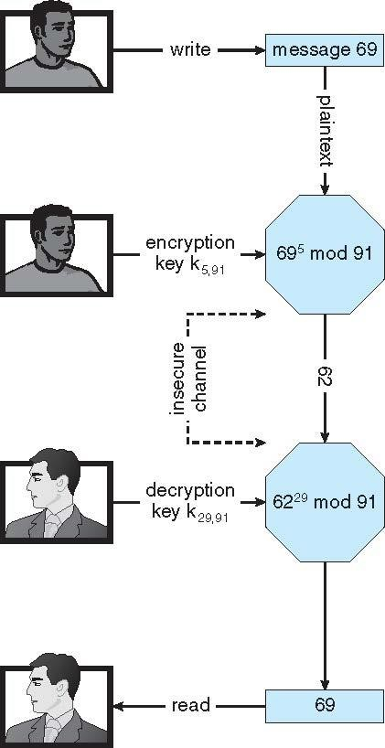
Encryption using RSA Asymmetric Cryptography
Notes:
ความแตกต่างจาก Sym คือ ไม่จำเป็นต้องแลกเปลี่ยน KEY อีกแล้ว แต่ข้อเสีคือมันช้า แต่จริงๆแล้วทำ2 step คือ 1. Link server สร้าง secure channel แล้วสร้าง KeyExchange ออกมาแล้วใช้ Encrypt Sym ที่Secure แล้วยังเร็วด้วย

Slide 36
Cryptography (Cont.)
Note symmetric cryptography based on transformations, asymmetric based on mathematical functions
Asymmetric much more compute intensive
Typically not used for bulk data encryption

Slide 37

Authentication
Constraining set of potential senders of a message
Complementary to encryption
Also can prove message unmodified
Algorithm components
A set K of keys
A set M of messages
A set A of authenticators
A function S : K → (M→ A)
 That is, for each k ∈ K, S_{k} is a function for generating authenticators from messages
 Both S and S_{k} for any k should be efficiently computable functions
A function V : K → (M A→ {true, false}). That is, for each k ∈ K,
V_{k} is a function for verifying authenticators on messages
 Both V and V_{k} for any k should be efficiently computable
functions
Notes:
ผลของตัว Public Key encryption เอามาใช้ในการระบุตัวตน Aut ได้ Concept คือ สมมุติว่าคุยกัน อยากรู้คุณเป็นใคร Public key อย่างเดียวไม่พอ เพราะยังไม่รู้ว่าเป็นใครจึงต้องมีวิธีระบุตัวตนโดยในระบบจะมีคนที่ไว้ใจได้คือ CA คุณต้องส่งให้ CA encrypt เป็น Private Key แล้วค่อยส่งไปให้ถอด เหมือนผมอยากรู้คุณเป็นคนดีป่าวต้องไปถามจารให้จารเซนใบรับรองให้

Slide 38
Authentication (Cont.)
For a message m, a computer can generate an authenticator
a ∈ A such that V_{k}(m, a) = true only if it possesses k
Thus, computer holding k can generate authenticators on messages so that any other computer possessing k can verify them
Computer not holding k cannot generate authenticators on messages that can be verified using V_{k}
Since authenticators are generally exposed (for example, they are sent on the network with the messages themselves), it must not be feasible to derive k from the authenticators
Practically, if V_{k}(m,a) = true then we know m has not been
modified and that send of message has k
If we share k with only one entity, know where the
message originated
Notes:
Authenticator เป็ยคน sign Authenticate จากนั้น Computer จะไม่สามารถ สร้างKey Aut ได้

Slide 39


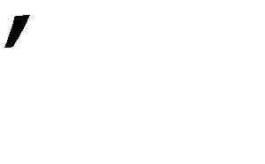
Authentication – Hash Functions
Basis of authentication
Creates small, fixed-size block of data message digest (hash
value) from m
Hash Function H must be collision resistant on m
Must be infeasible to find an m ≠ m such that H(m) = H(m )
If H(m) = H(m ), then m = m
The message has not been modified
Common message-digest functions include MD5, which produces a 128-bit hash, and SHA-1, which outputs a 160-bit hash
Not useful as authenticators
For example H(m) can be sent with a message
 But if H is known someone could modify m to m’ and recompute
H(m’) and modification not detected
 So must authenticate H(m)

Slide 40
Authentication - MAC
Symmetric encryption used in message-authentication code
(MAC) authentication algorithm
Cryptographic checksum generated from message using secret key
Can securely authenticate short values
If used to authenticate H(m) for an H that is collision resistant, then obtain a way to securely authenticate long message by hashing them first
Note that k is needed to compute both S_{k} and V_{k}, so anyone
able to compute one can compute the other
15.40

Slide 41
Authentication – Digital Signature
Based on asymmetric keys and digital signature algorithm
Authenticators produced are digital signatures
Very useful – anyone can verify authenticity of a message
In a digital-signature algorithm, computationally infeasible to
derive k_{s} from k_{v}
V is a one-way function
Thus, k_{v} is the public key and k_{s} is the private key
Consider the RSA digital-signature algorithm
Similar to the RSA encryption algorithm, but the key use is
reversed
Digital signature of message S_{ks} (m) = H(m)^{k}s mod N
The key k_{s} again is a pair (d, N), where N is the product of
two large, randomly chosen prime numbers p and q
Verification algorithm is V_{kv}(m, a)
(a^{k}v mod N = H(m))
 Where k_{v} satisfies k_{v}k_{s} mod (p − 1)(q − 1) = 1
Notes:
เป็นการอธิบายที่ยุ่งยากไปฟมไม่ได้ใช้

Slide 42
Authentication (Cont.)
Why authentication if a subset of encryption?
Fewer computations (except for RSA digital signatures)
Authenticator usually shorter than message
Sometimes want authentication but not confidentiality
 Signed patches et al
Can be basis for non-repudiation

Slide 43
Key Distribution
Delivery of symmetric key is huge challenge
Sometimes done out-of-band
Asymmetric keys can proliferate – stored on key ring
Even asymmetric key distribution needs care – man-
in-the-middle attack

Slide 44
Digital Certificates
Proof of who or what owns a public key
Public key digitally signed a trusted party
Trusted party receives proof of identification from entity and certifies that public key belongs to entity
Certificate authority are trusted party – their public keys
included with web browser distributions
They vouch for other authorities via digitally signing their keys, and so on
Notes:
นี่คือ Concept พี้นฐาน เราจะมี party นึงคือ CA Certificate authority เป็นคนดูแล Public Key เช่นพวก Browser

Slide 45
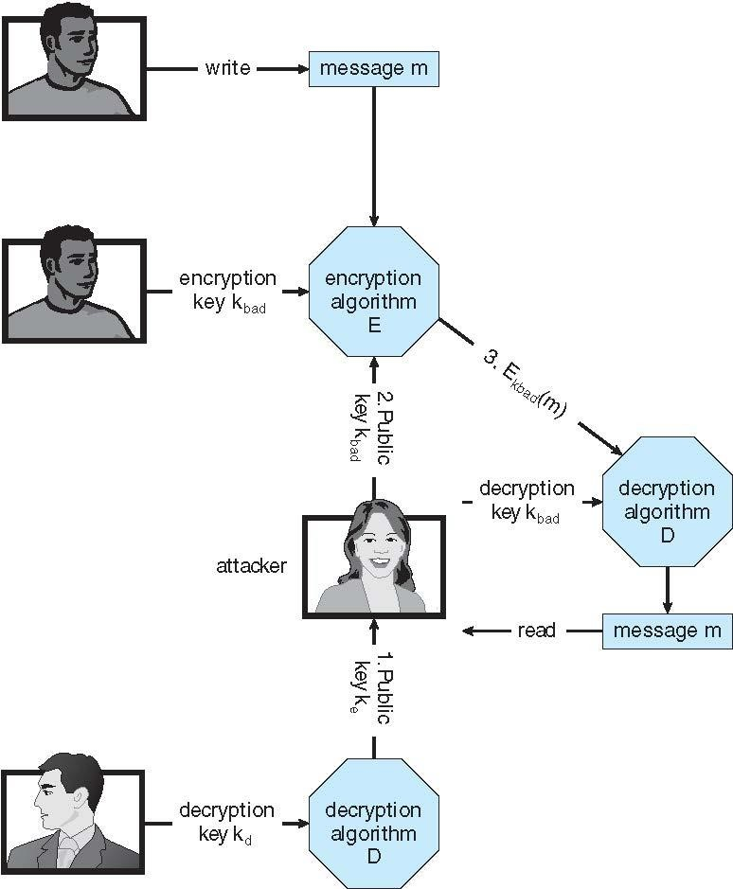
Man-in-the-middle Attack on Asymmetric Cryptography
Notes:
Attacker! สามารถ Track ได้โดยจะพยายามปลอมตัว Public key มาดัก Message ที่ส่งผ่านใน เครือข่าย

Slide 46
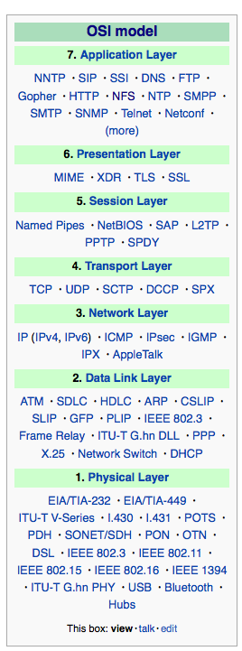
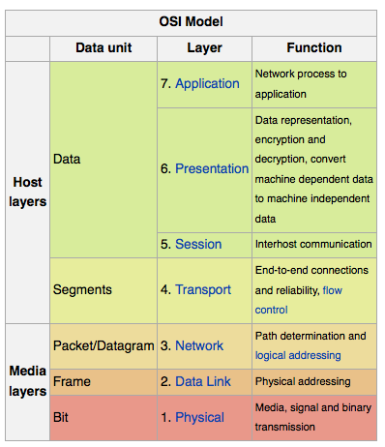
Implementation of Cryptography
15.46
Can be done at various layers of ISO Reference Model
SSL at the Transport layer
Network layer is typically
IPSec
 IKE for key exchange
 Basis of Virtual Private
Networks (VPNs)
Why not just at lowest level?
Sometimes need more knowledge than available at low levels
 i.e. User authentication
 i.e. e-mail delivery
Source: http://en.wikipedia.org/wiki/OSI_mo del
Notes:
Securityควร Implementได้หลายเลเวล ตามมาตรฐาน ใส่ได้หลายๆจุดเช่นในระดับ IP = IPSECT APP=SSL เป็นต้น คำถามคือมันควรใช้ใน levelไหนถ้าเราใช้ใน Low lever ถ้าเราใช้ระดับล่างมากๆ มันจะใช้เวลา encrypt decrypt ที่ไม่จำเป็นทำให้เสียเวลา แต่ถ้าไปใช้กับ layer สูงๆ App จะได้ สมรรถนะที่ดีกว่า ถ้าใช้ระดับ Network แล้ว App ก็ไม่จำเป็นต้อง Enc,Dec แล้ว

Slide 47
Encryption Example - SSL
Insertion of cryptography at one layer of the ISO network model (the transport layer)
SSL – Secure Socket Layer (also called TLS)
Cryptographic protocol that limits two computers to only exchange messages with each other
Very complicated, with many variations
Used between web servers and browsers for secure communication (credit card numbers)
The server is verified with a certificate assuring client is talking to correct server
Asymmetric cryptography used to establish a secure session key
(symmetric encryption) for bulk of communication during session
Communication between each computer then uses symmetric key
cryptography
More details in textbook
Notes:
Encryption ที่ insert ใน Protocol เวลาเปิด Session โดย Seer verified กับตัว Certificate ว่า Client เป็นตัวที่ถูกต้องมั้ย Asym จะสร้าง session key เพื่อสร้าง Communication secure แล้วใช้ Sym ทำใหไว

Slide 48

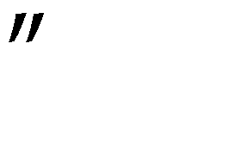
User Authentication
Crucial to identify user correctly, as protection systems depend on user ID
User identity most often established through passwords, can be considered a special case of either keys or capabilities
Passwords must be kept secret
Frequent change of passwords
History to avoid repeats
Use of non-guessable passwords
Log all invalid access attempts (but not the passwords themselves)
Unauthorized transfer
Passwords may also either be encrypted or allowed to be used only once
Does encrypting passwords solve the exposure problem?
 Might solve sniffing
 Consider shoulder surfing
 Consider Trojan horse keystroke logger
 How are passwords stored at authenticating site?
Notes:
พื้นฐาน Authe โดย Password แต่สามารถถูกขโมยไปได้ จากหลายๆช่องทาง

Slide 49

Passwords
Encrypt to avoid having to keep secret
But keep secret anyway (i.e. Unix uses superuser-only readably file
/etc/shadow)
Use algorithm easy to compute but difficult to invert
Only encrypted password stored, never decrypted
Add salt to avoid the same password being encrypted to the same value
One-time passwords
Use a function based on a seed to compute a password, both user and
computer
Hardware device / calculator / key fob to generate the password
 Changes very frequently
Biometrics
Some physical attribute (fingerprint, hand scan)
Multi-factor authentication
Need two or more factors for authentication
 i.e. USB dongle , biometric measure, and password
Notes:
ทำไงให้ Password Secure เวลาเก็บ Password ต้อง encryptโดยทีต้องมี Algor ทีคำนวนง่ายถอดยาก ตอนนี่มีระบบหลายอย่างที่ทำให้ Secure ขึ้นเช่น One time password หรือ CardPasswordการ์ดGenPassตามกาลเวลา Biometric นิ้ว

Slide 50
Implementing Security Defenses
Defense in depth is most common security theory – multiple layers of security
Security policy describes what is being secured
Vulnerability assessment compares real state of system / network compared to
security policy
Intrusion detection endeavors to detect attempted or successful intrusions
Signature-based detection spots known bad patterns
Anomaly detection spots differences from normal behavior
 Can detect zero-day attacks
False-positives and false-negatives a problem
Virus protection
Searching all programs or programs at execution for known virus patterns
Or run in sandbox so can’t damage system
Auditing, accounting, and logging of all or specific system or network activities
Practice safe computing – avoid sources of infection, download from only “good” sites, etc
15.50
Notes:
Defense in dept คือ Sec ต้องมีหลายๆ Layer ต้องคอยตรวจสอบ

Slide 51
Firewalling to Protect Systems and Networks
A network firewall is placed between trusted and untrusted hosts
The firewall limits network access between these two security
domains
Can be tunneled or spoofed
Tunneling allows disallowed protocol to travel within allowed
protocol (i.e., telnet inside of HTTP)
Firewall rules typically based on host name or IP address which can be spoofed
Personal firewall is software layer on given host
Can monitor / limit traffic to and from the host
Application proxy firewall understands application protocol and
can control them (i.e., SMTP)
System-call firewall monitors all important system calls and apply
rules to them (i.e., this program can execute that system call)
Notes:
อีกอย่างนึงคือในระบบ Network จะมีการติดตั้ง FireWall PF AF SF พวกนี้ต้องขวางระหว่าง untrusted envo กับ trusted envo

Slide 52
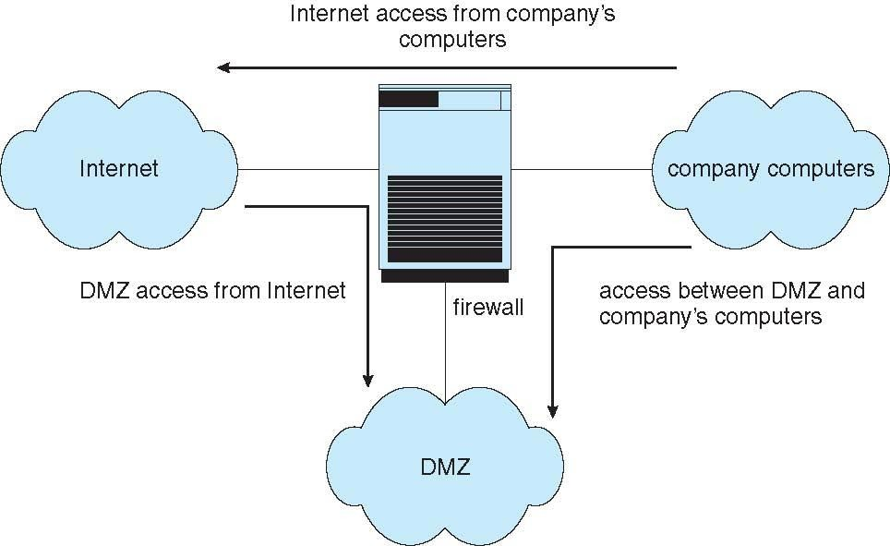
Network Security Through Domain Separation Via Firewall

Slide 53
Computer Security Classifications
U.S. Department of Defense outlines four divisions of computer security: A, B, C, and D
D – Minimal security
C – Provides discretionary protection through auditing
Divided into C1 and C2
 C1 identifies cooperating users with the same level of protection
 C2 allows user-level access control
B – All the properties of C, however each object may have
unique sensitivity labels
Divided into B1, B2, and B3
A – Uses formal design and verification techniques to ensure
security
Notes:
กระลาโหม สหรัฐ แบ่งออกไปเป็น คลาส ABCD มาก->น้อย Dไมทำไรเลย Cพื้นฐาน Bพวกธุรกิจ Aทหาร

Slide 54
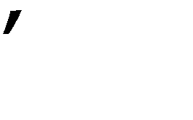
Example: Windows 7
Security is based on user accounts
Each user has unique security ID
Login to ID creates security access token
 Includes security ID for user, for user privileges
 Every process gets copy of token
s groups, and special
 System checks token to determine if access allowed or denied
Uses a subject model to ensure access security
A subject tracks and manages permissions for each program that a user runs
Each object in Windows has a security attribute defined by a security
descriptor
For example, a file has a security descriptor that indicates the
access permissions for all users
Notes:
ไม่มีไรเหมือนกันหมด Base on user Account มี Access Toke พอ login ปัปจะใช้ Access token จัดการระบบให้ Secure

Slide 55
Example: Windows 7 (Cont.)
Win added mandatory integrity controls – assigns integrity label to each securable object and subject
Subject must have access requested in discretionary
access-control list to gain access to object
Security attributes described by security descriptor
Owner ID, group security ID, discretionary access-control list, system access-control list

Slide 56
End of Chapter 15
Operating System Concepts – 9th Edition

Slide 57
สรุป
Memmory management
Io structure –
Mass Storage จะ Scheduling ยังไงซ้ายขวาช้าเร็ว Rate 0 1 Combine Rate 0+1 ยังไงฃ
File System –Asy sym tree flash directory code read write implementation2อย่าง เป็นไง Directory strc File strc Freespace strc ใน Direc แบ่งเป็น Dosเป็นไร
Protection Domain ข้อดีข้อเสียเป็นยังไง Access write access control เป็นไงดียังไง
ไม่ไปสมการประหลาดเอาแต่ Concept

